Slide 1

JAVA PROJECT
JAVA
MOVIE WEBSITE
(LIKE NETFLIX)
By:
-Jay Bhattarai (1BM19IS198)
-Sachin Madhesiya (1BM19IS206)

Slide 2

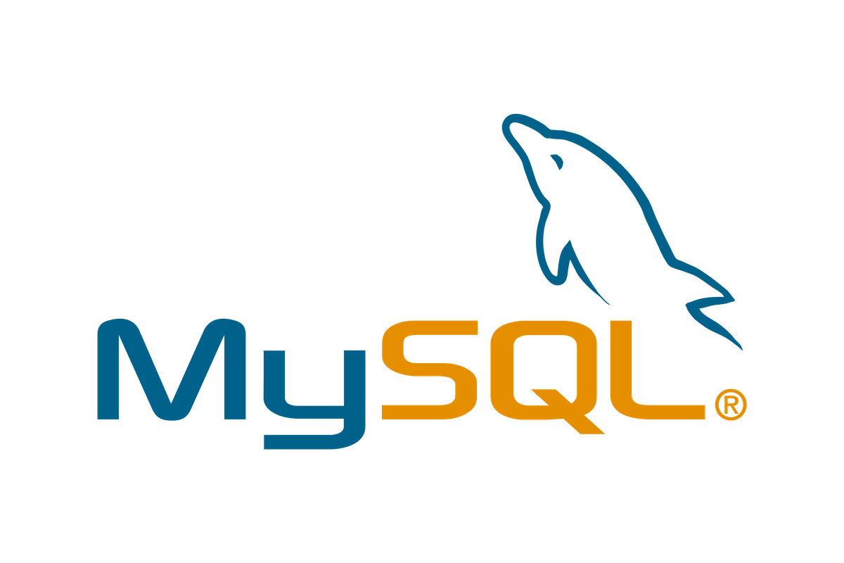

TECHNOLOGIES USED
jAVA
01
HANDLING ALL THE BACKEND ROUTING AND MANAGING THE APPLICATION STATE
02
MYSQL
MYSQL DATABASE TO STORE AND RETRIVE ALL THE DATA.
03
REACT JS
FRONTEND/UI TO DISPLAY ALL THE CONTENT

Slide 3
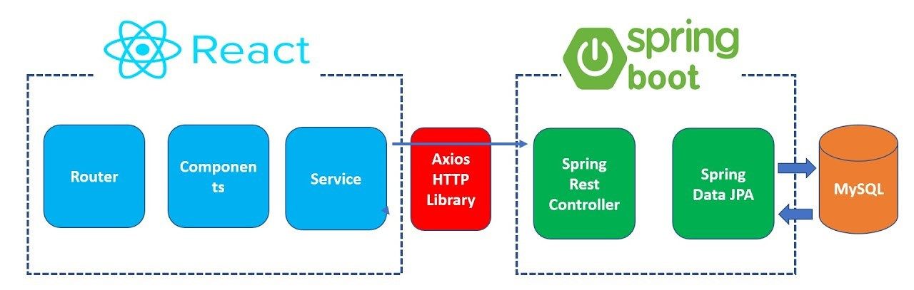
ARCHITECTURE

Slide 4
WORKING OF JAVA UNDER THE HOOD
SPRING BOOT
-MAIN BACKEND SERVER
MYSQL CONNECTOR
-TO CONNECT WITH MYSQL BACKEND
JPA(Java Persistant API)
-FOR HANDLING THE DATABASE DATA

Slide 5
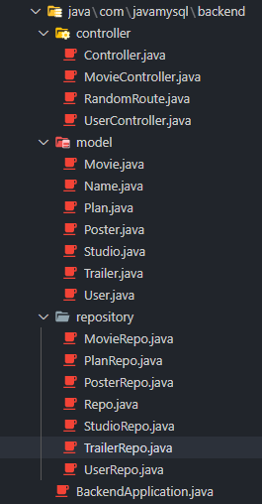
CODE STRUCTURE
Controller
-To controll the routes
Model
-Database Models
Repository
-Fetching required data from DB

Slide 6
HOW THE WHOLE APPLICATION WORKS?
Step 1
Step 2
Step 3
FRONTEND WILL ASK FOR THE DATABASE DATA USING THE SPRINGBOOT API
SPRING BOOT SERVER WILL HANDLE THE INCOMING REQUEST AND SENDS RESPONSE
FRONTEND WILL DISPLAY THOSE DATA TO THE END USERS
GET REQUEST FROM FRONTEND
SPRING WORKING AS MIDDLEWARE
DATABASE RESPONSE TO FRONTEND

Slide 7

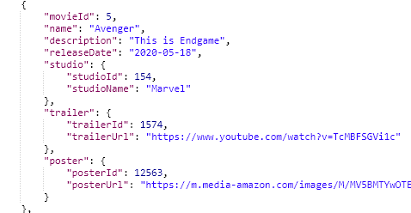
WORKING

Slide 8
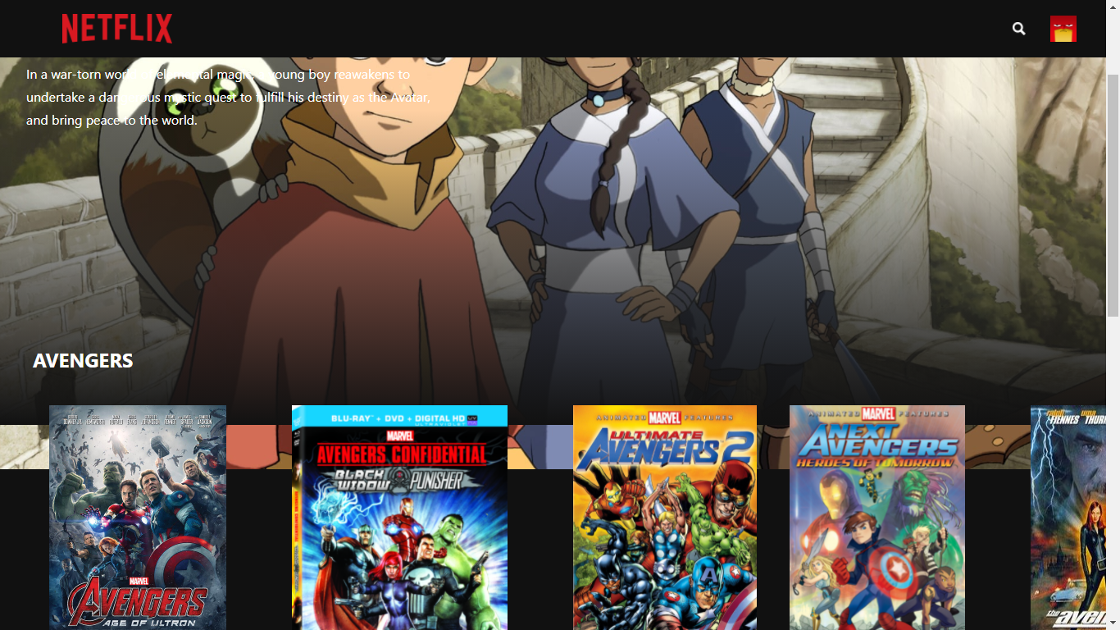

Slide 9
TOOLS USED
Programming languages, framework and libraries
-JAVA
-Spring Boot
-JPA
-My SQL Connector
-Maven (Java build Automation Tool)
-JAVASCRIPT
-React JS (for frontend ui)
-Axios (for frontend request handle)
-MYSQL

Slide 10
THANK YOU!
System.out.println(presenter += 1)

